Slide 1
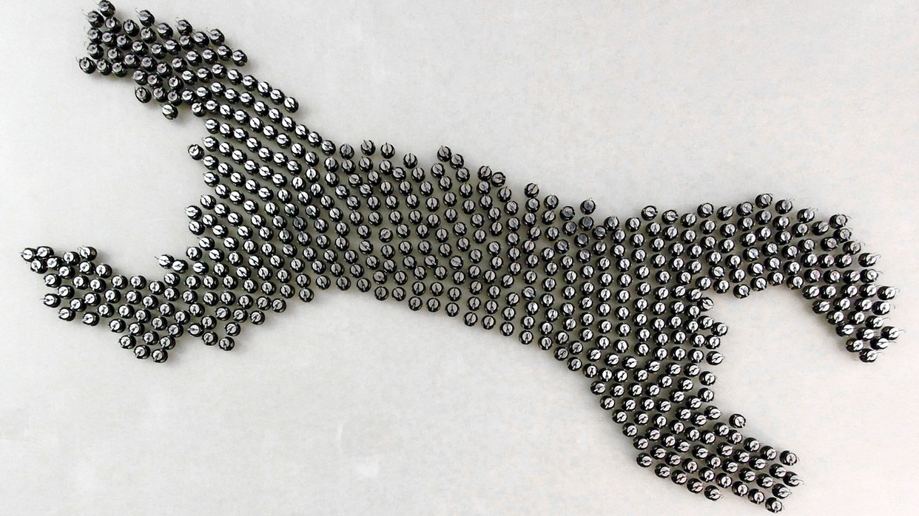
Swarming Robots
Name: Amirul Haikal Bin Shahrin
Matric Number: 1912521

Slide 2
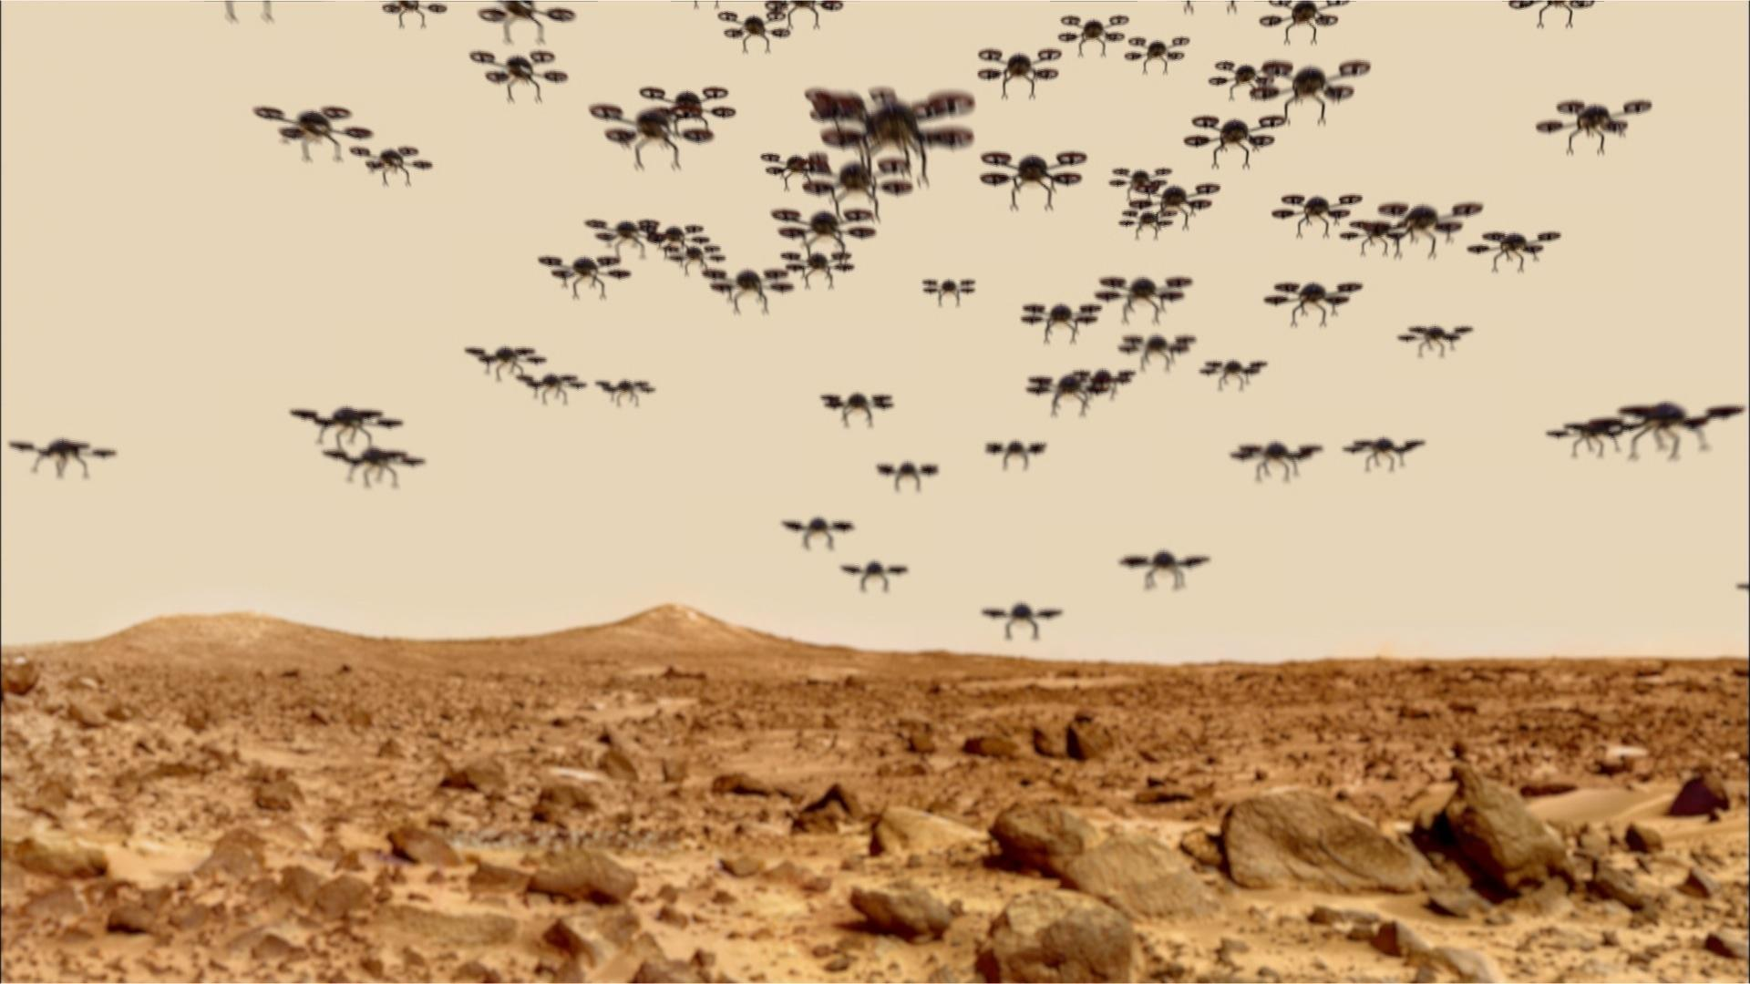
Introduction
Swarming robots are a type of robotic system in which multiple robots work together to achieve a common goal.
These robots are designed to communicate and coordinate with one another to form a collective intelligence that is greater than the sum of their individual abilities.
Hardware components are a critical part of these systems, and they are responsible for providing the robots with the necessary tools to perform their tasks efficiently.

Slide 3
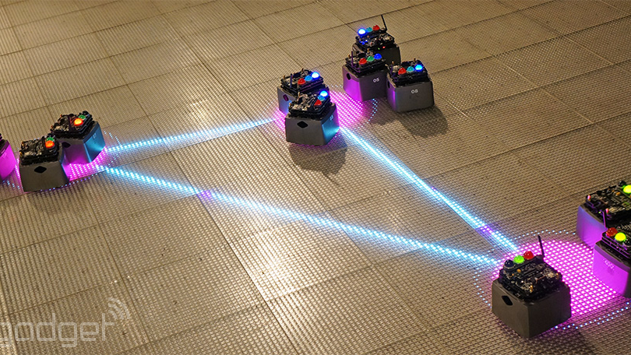
Main Components
Locomotion (Wheels, Propellers & Legs)
Microcontroller
Data Collection (Sensors)
Data Transmission (Wifi & Bluetooth)
Actuation Hardware (DC Motors & Servo Motors)
Power Management (Battery & Solar Panel)

Slide 4
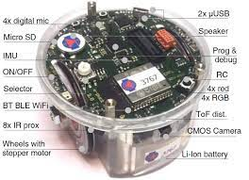
Locomotion (Wheels)
E-puck
Wheels are a common locomotion component used in swarming robots, especially for ground-based robots.
They provide a simple and efficient means of moving the robot around, allowing for fast and agile movement.
One of the examples is the e-puck.

Slide 5
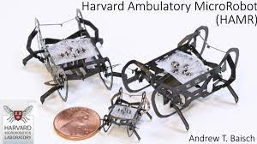
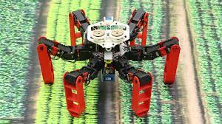
Locomotion (Legs)
HAMR
Antbot
Legs are another type of locomotion component used in swarming robots, especially for robots that need to navigate rough terrain or climb over obstacles.
Legged robots can move in a variety of ways, including walking, running, and jumping, giving them greater flexibility in their movement.

Slide 6
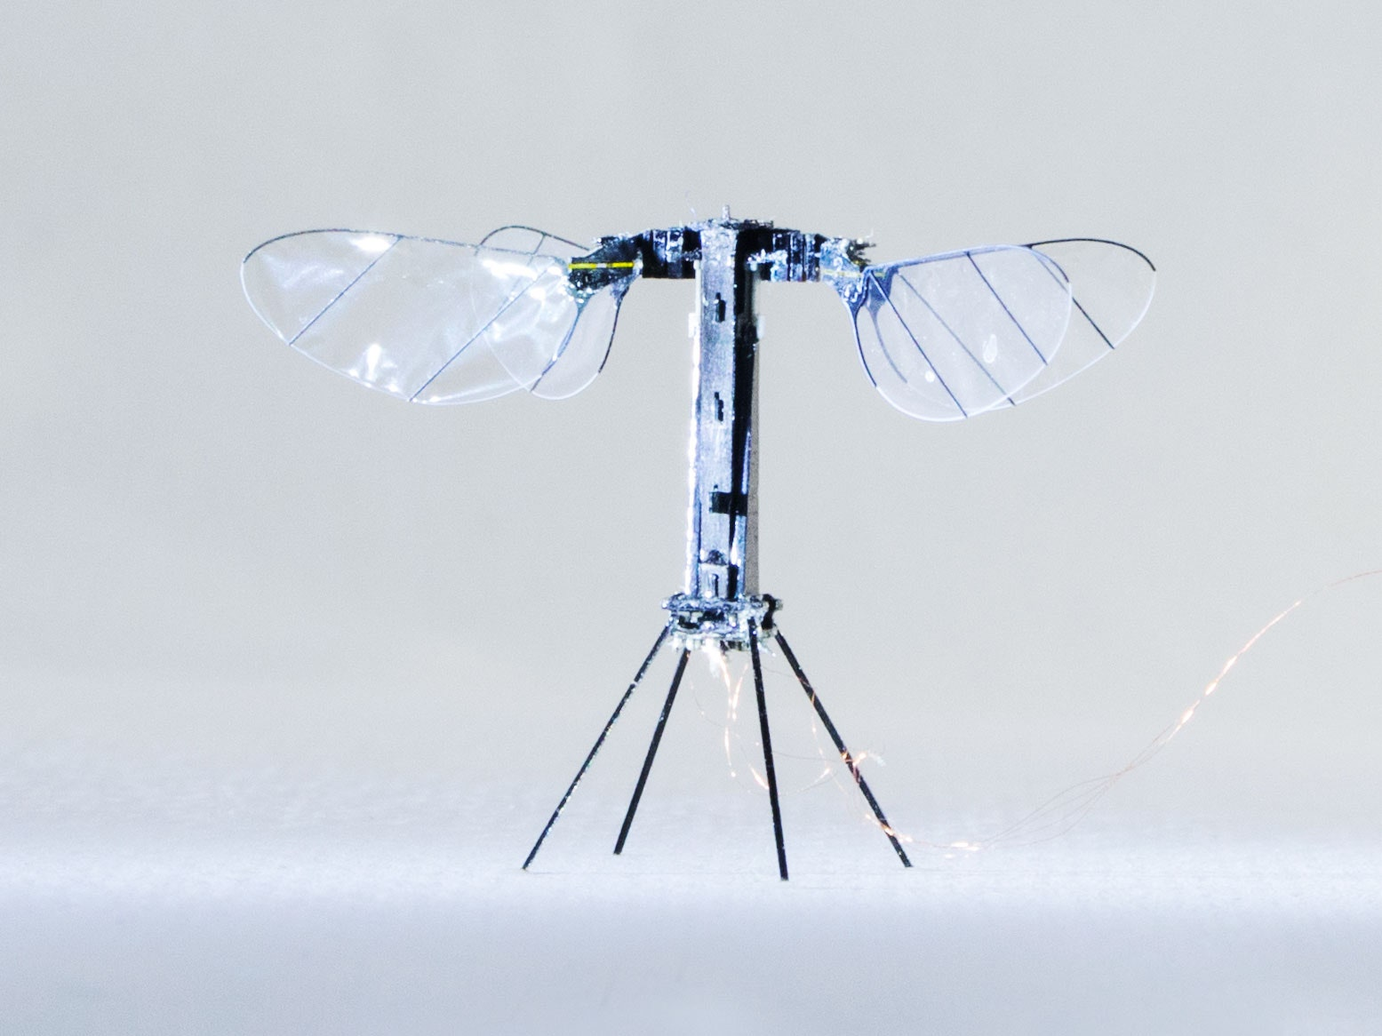
Locomotion (Propellers)
RoboBees
Propellers are used in swarming robots that need to fly, such as aerial drones.
They provide lift and allow the robot to move vertically and horizontally through the air.
Propellers can be fixed or adjustable, allowing for greater control over the robot's movement.

Slide 7
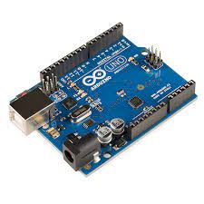
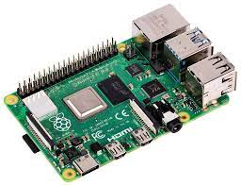
Microcontroller
A microcontroller is the brain of a robot that controls all the robot's functions, such as processing sensor data, communicating with other robots, and performing actions.
Some examples of microcontrollers used in swarming robots are:
Arduino
Raspberry Pi
Raspberry Pi
Arduino

Slide 8
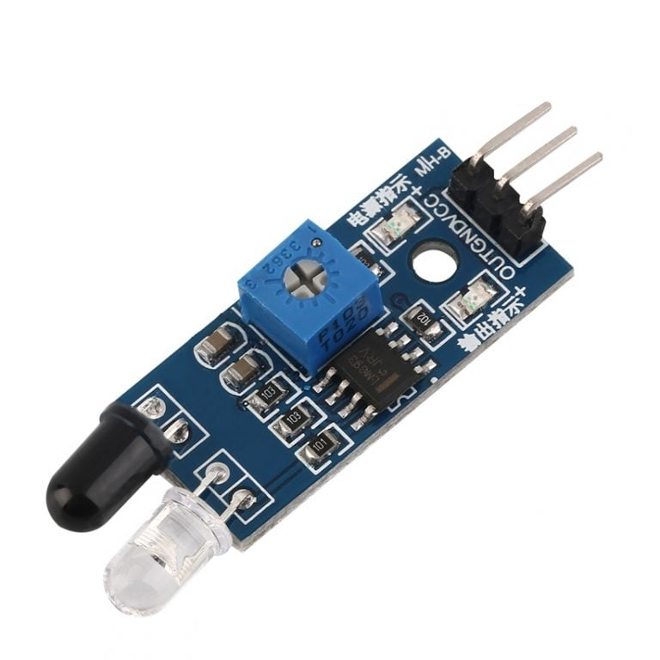
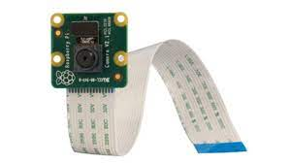
Data Collection (Sensors)
A microcontroller is the brain of a robot that controls all the robot's functions, such as processing sensor data, communicating with other robots, and performing actions.
Some examples of microcontrollers used in swarming robots are:
Infrared sensors (IR): IR sensors are commonly used in swarming robots to detect the distance between robots. They emit a beam of infrared light that reflects off the other robot and measures the time taken for the light to return, giving an estimate of the distance between them.
Camera sensors: Camera sensors are used in swarming robots to capture images and video of the environment. These images can be used for object recognition and navigation purposes.
Infrared Sensor
Raspberry Pi Camera Module

Slide 9
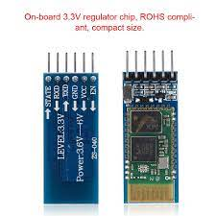
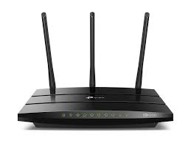
Data Transmission
Communication devices allow robots to communicate with each other and share information. Some examples of communication devices used in swarming robots are:
Wi-Fi: Wi-Fi is a wireless communication technology commonly used in swarming robots to transmit data between robots. It provides high bandwidth and long-range communication capabilities.
Bluetooth: Bluetooth is a wireless communication technology commonly used in swarming robots to transmit data between robots. It provides low-power and short-range communication capabilities.
Bluetooth Module
Archer C1200 (WIFI)

Slide 10
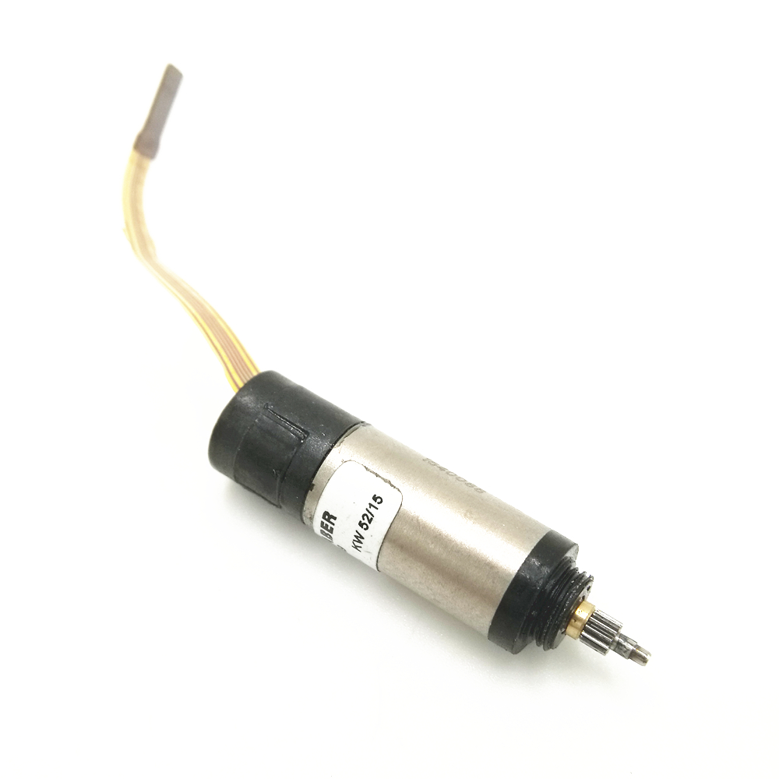
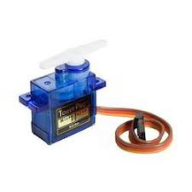
Actuators
Faulhaber 2660 8mm Brushless DC Micromotor
TowerPro SG90 Micro Servo Motor
Actuators are components that provide motion to the robot. They are responsible for controlling the robot's movement and performing tasks. Some examples of actuators used in swarming robots are:
DC motors: DC motors are commonly used in swarming robots for their simplicity and low cost. They are used to control the robot's speed and direction of movement.
Servo motors: Servo motors are used in swarming robots for their precision and ability to control the robot's movement accurately. They are commonly used in robotic arms to perform tasks that require fine control.

Slide 11
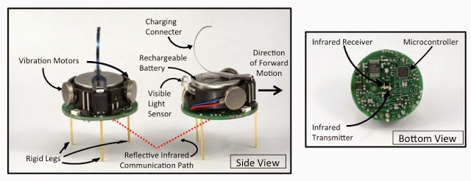
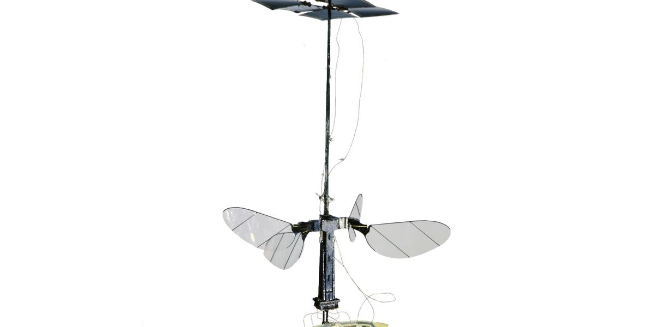
Power Management (Batteries & Charger)
Batteries: Batteries are a common power source used in swarming robots. They provide a portable and reliable source of power that can be easily recharged. Swarming robots may use a variety of battery types, such as lithium-ion or nickel-metal hydride batteries, depending on their power requirements and operating conditions. For example, the Kilobot swarm robot uses a lithium-polymer battery that provides up to 9 hours of continuous operation.
Solar Panels: Solar panels are another type of power source used in swarming robots, especially for robots that operate in outdoor environments with ample sunlight. Solar panels provide a renewable source of energy that can be used to recharge batteries or power the robot directly. Some examples of swarming robots that use solar panels for power management include the RoboBees.
Lithium-polymer battery in Kilobot
Solar-powered RoboBees

Slide 12
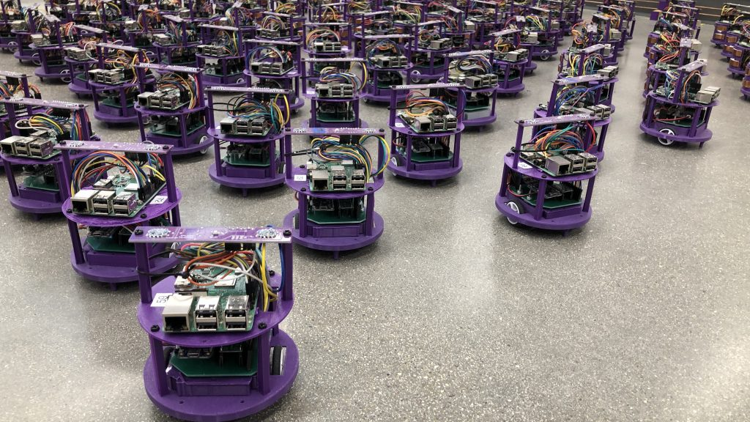
Summary
In conclusion, swarming robots are complex systems that require a range of hardware components to function effectively. Locomotion components, such as wheels or legs, are necessary to enable the robots to move around and navigate their environment. Sensor components, such as camera sensors or infrared sensors, provide the robots with information about their surroundings, which they can use for object recognition, obstacle avoidance, and other tasks. Communication components, such as wireless modules or Bluetooth devices, allow the robots to communicate with each other and coordinate their actions. Power management is also a critical aspect of swarming robots, and the hardware components used for power management can greatly affect the robot's ability to operate effectively. Batteries, solar panels, power management circuits, and energy harvesting technologies are just a few examples of hardware components used in swarming robots for power management, and they all play a critical role in enabling the robots to operate reliably and efficiently. Overall, the hardware components used in swarming robots are diverse and varied, reflecting the complexity of the systems involved. By carefully selecting and integrating these components, developers can create swarming robots that are capable of working together effectively to achieve a wide range of tasks, from environmental monitoring and disaster response to industrial automation and precision agriculture.

